Slide 1

Bachelor Of Technology
Computer Science and Engineering (Data Science)
311 Program in collaboration with Virginia Tech. USA
Mini-Project Presentation
SVKM’s NMIMS
Mukesh Patel School of Technology Management and Engineering, JVPD, Vile Parle, West
Mumbai- 400056

Slide 2

A PRESENTATION ON
“SALES FORECASTING FOR WOWMART”
By
NIHARIKA AMRITKAR
SHREYAS DESAI
KAUNCHI JAIN
Faculty Mentors:
Prof. Ami Munshi, Prof. Mahesh Mali and Prof. Khinal Parmar

Slide 3
Contents
Introduction
Literature Survey
Problem Statement
System Description
Implementation
Result and Analysis
Conclusion
Future Scope
References

Slide 4
Introduction
For our project, we are taking help of WoW-Mart, a fictional company and using it’s sales related dataset to carry out the operations. Our project aims at predicting sales for the store’s outlets in various locations and regions and helping the management staff to take decisions like whether a particular region, or outlet in general is proving profitable for them or not and whether they should continue operating there.
Our Experiment will also help WoW-Mart to help them in planning their supplies, incase a specific region or store is expecting heavy demand, then more supplies can be directed towards it, and if some store is expecting fall in demand, then it can either be shut or less resources can be directed towards it.

Slide 5
Literature Survey
We surveyed 3 research papers on Moving Average:
1) Ms. Savita Satav, Dr. Netra Apte: “The Moving Average Crossover Strategy: A Study”, JMME, Volume 10, No. 03, July 2020, pp- 141- 146
2) Puchong Praekhaow: “Determination of Trading Points using Moving Average Methods”, June 2010.
3) Seng Hansun: “A Novel Research of New Moving Average Method in Time Series Anaysis”, August 2014

Slide 6
Problem Statement
To forecast sales with the help of Moving Averages on the basis of Stores, Locations and Regions for comparative analysis.
To identify crossovers and MAD for prediction of trend and volatility in sales for the next quarter.

Slide 7
System Description
Hardware requirements:
Functional Computer with sufficient RAM
Software requirements:
Jupyter Notebook
SAS
Excel
Microsoft Presentation, Microsoft Word

Slide 8
Algorithm
Obtaining dataset through statistic means and organizing it
Cleaning irrelevant data and managing null values
Specifying the purpose of the analysis and opting for suitable method to analyze the dataset
Working through the programming algorithm to develop the fundamentals
Implementing the analysis technique using python
Importing dataset in the python notebook and working with the fundamentals developed
Making program flexible to different types of statistical data
Running the code and checking if the code works for all types of Inputs
Error management
Concluding the finding of the program
Analyzing the findings of the program
Commenting on the analysis with regard to sales and predicting the trend with the help of MAD, Crossovers, Variance and Standard Deviation

Slide 9
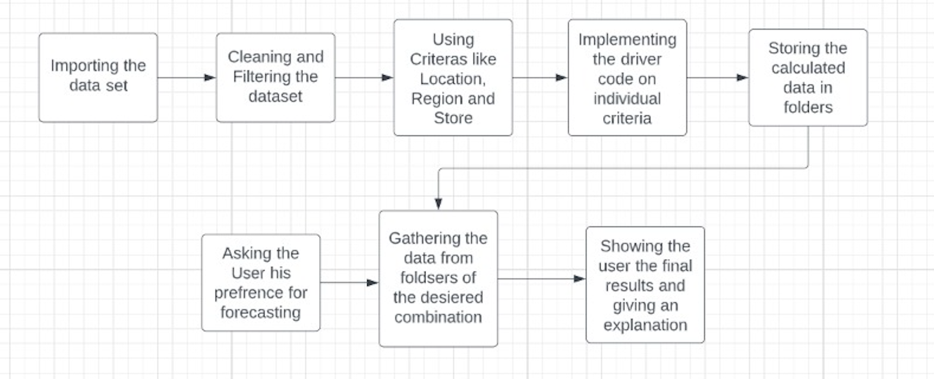
Flowchart & Block Diagram

Slide 10
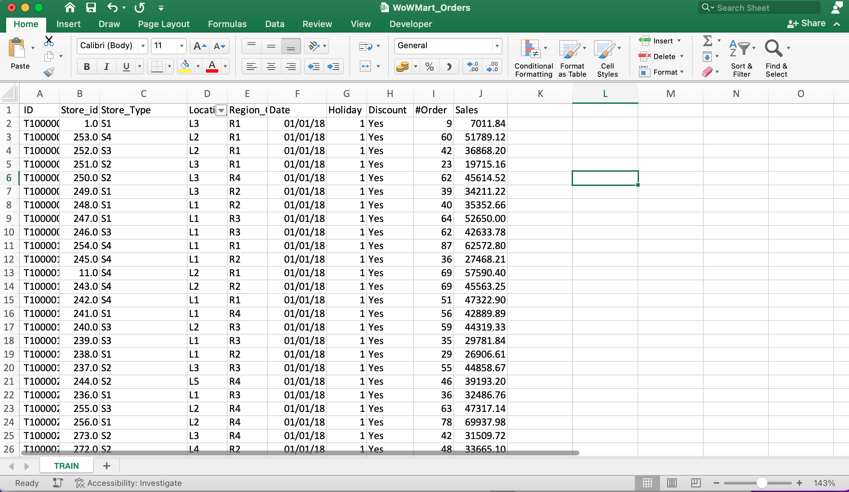
Our Dataset

Slide 11
Data Cleaning
Discounts, Order Id, Holidays and Order number was removed using python.
A new variable was created and the useful information was stored in it.
The variable was later converted to .csv file, which is the data we worked on.

Slide 12
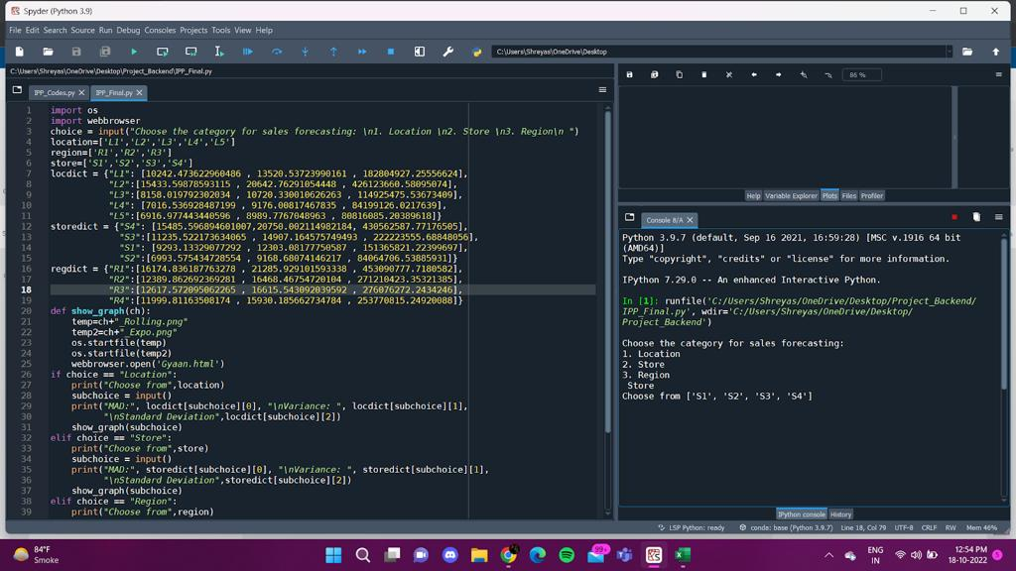
Project Outlook
Let’s look at the sales of store type S1 and predict how will it perform in the next quarter.

Slide 13
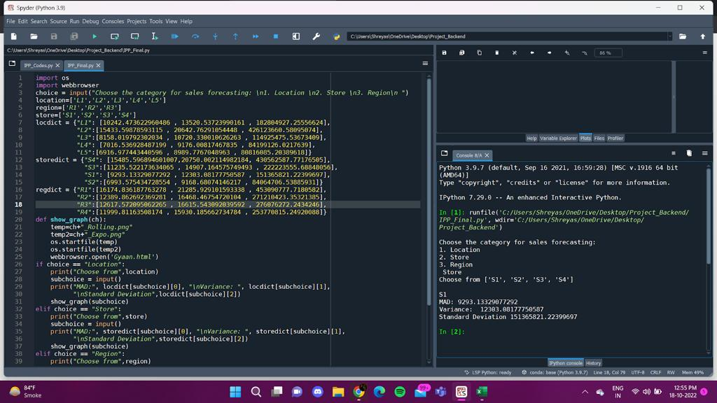
We chose Store from menu and then chose S1 for the results

Slide 14
Results:
MAD is derived
Standard Deviation is calculated
Variance is calculated
2 graphs are generated:
Simple Moving Average with 1 window size
Exponential Moving Average with 2 window sizes
Manual to analyze the results is popped up

Slide 15
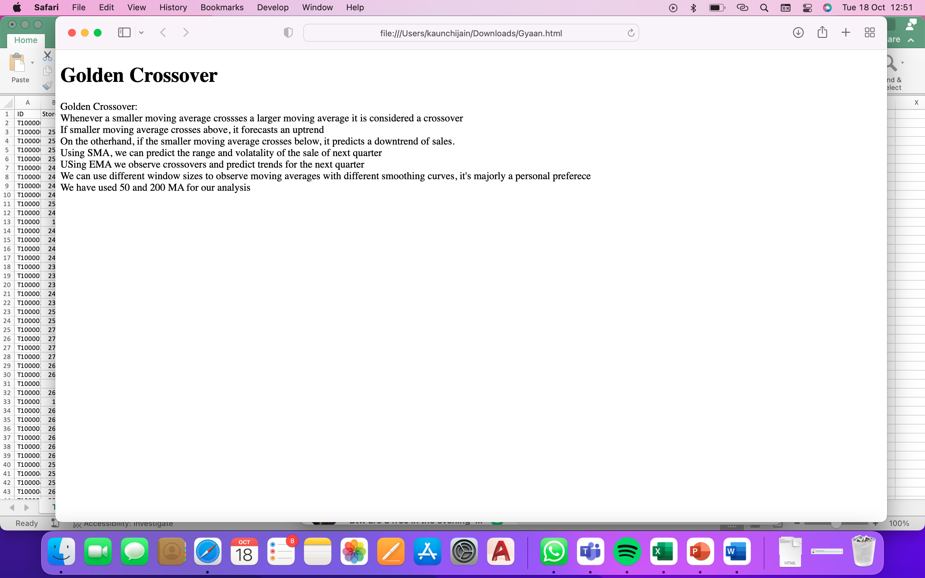
Manual using HTML

Slide 16
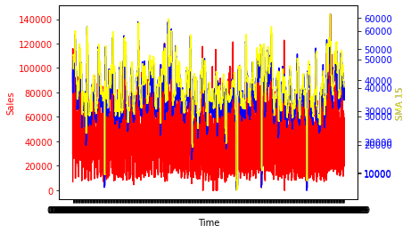
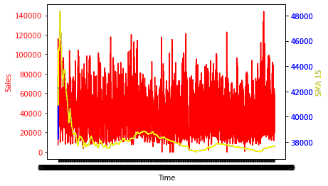
Graphs
SMA
EMA

Slide 17
Concepts Used: IBSAM Statistics
Moving Average
Simple Moving Average
Exponential Moving Average
Standard Deviation
Variance
Mean Absolute Deviation
Crossovers in Moving Averages of 2 window sizes
Forecasting: Uptrend & Downtrends

Slide 18
Implementation: Driver code
choicedf = region_list.rolling(50)
choicedf1 = region_list.rolling(200)
moving_average=choicedf.mean()
moving_average_list = moving_average.tolist()
moving_average_list = np.array(moving_average_list)
moving_average1=choicedf1.mean()
moving_average_list1 = moving_average1.tolist()
moving_average_list1 = np.array(moving_average_list1)
Calculating values for SMA

Slide 19
fig, ax1 = plt.subplots()
ax1.set_xlabel('Time')
ax1.set_ylabel('Sales', color = 'red')
ax1.plot(specific_region['Date'], specific_region['Sales'], color = 'red')
ax1.tick_params(axis ='y', labelcolor = 'red')
ax2 = ax1.twinx()
ax2.set_ylabel('SMA', color = 'blue')
ax2.plot(specific_region['Date'],moving_average_list , color = 'blue')
ax2.tick_params(axis ='y', labelcolor = 'blue')
ax3 = ax1.twinx()
ax3.set_ylabel('SMA', color = 'yellow')
ax3.plot(specific_region['Date'], moving_average_list1, color = 'yellow')
ax3.tick_params(axis ='y', labelcolor = 'blue')
plt.show()
Plotting 2 values on y-axis and one value on x axis i.e. dates

Slide 20
Main code
def show_graph(ch):
temp=ch+"_Rolling.png"
temp2=ch+"_Expo.png"
os.startfile(temp)
os.startfile(temp2)
webbrowser.open('Gyaan.html')
if choice == "Location":
print("Choose from",location)
subchoice = input()
print("MAD:", locdict[subchoice][0], "\nVariance: ", locdict[subchoice][1],
"\nStandard Deviation",locdict[subchoice][2])
show_graph(subchoice)
elif choice == "Store":
print("Choose from",store)
subchoice = input()
print("MAD:", storedict[subchoice][0], "\nVariance: ", storedict[subchoice][1],
"\nStandard Deviation",storedict[subchoice][2])
show_graph(subchoice)
elif choice == "Region":
print("Choose from",region)
subchoice = input()
print("MAD:", regdict[subchoice][0], "\nVariance: ", regdict[subchoice][1],
"\nStandard Deviation",regdict[subchoice][2])
show_graph(subchoice)
else:
print("Invalid Choice")
Taking input for required analysis and using code flexibility to predict sales for the same

Slide 21
Concepts used: Python
Numpy
Functions
Pandas
Matplotlib
Lambda functions
Data Structures

Slide 22
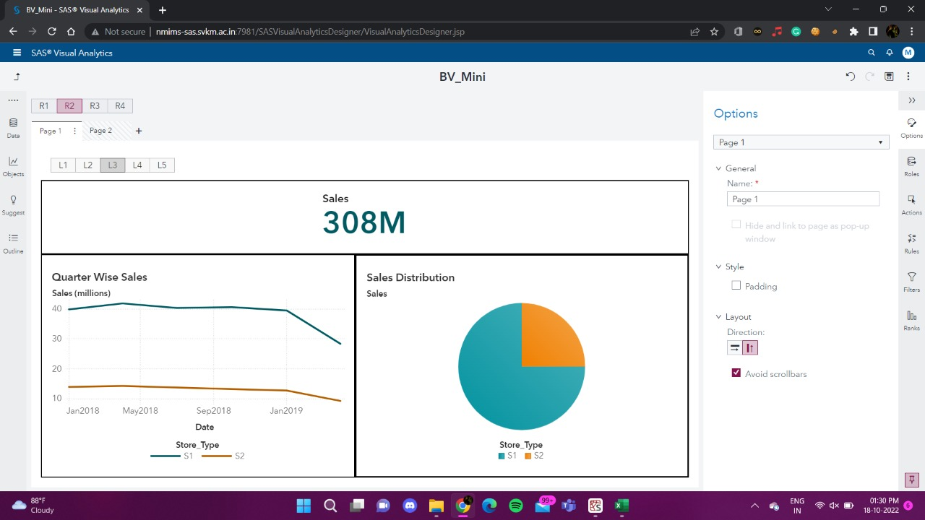
Visualization of Data

Slide 23
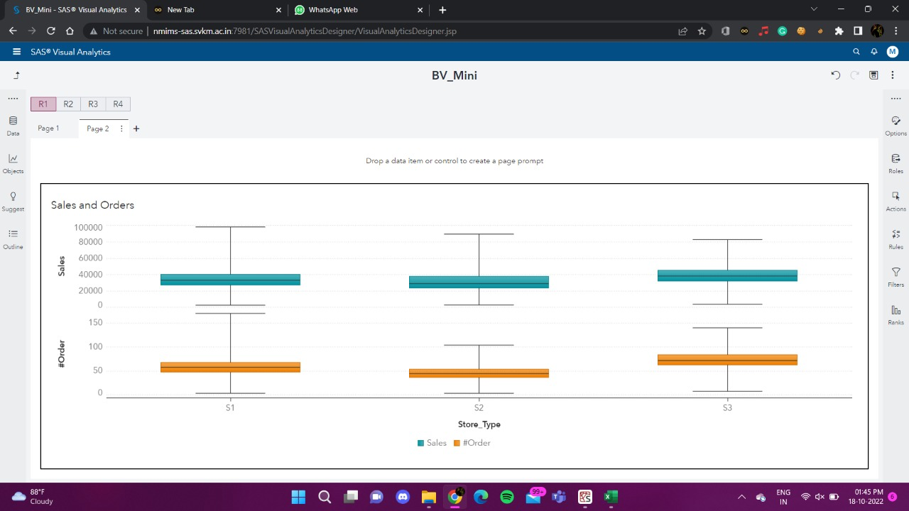
Directed Page Link

Slide 24
Concepts Used: Business Visualization
Action Prompts
Pie Chart
Line Chart
Box Plot
Information Graphics
Hidden Pages and page links

Slide 25
Result and Analysis
Whenever a smaller moving average crosses a larger moving average, it is considered a crossover.
If smaller moving average crosses above, it forecasts an uptrend.
On the other hand, if the smaller moving average crosses below, it predicts a downtrend of sales.
Using SMA, we can predict the range and volatility of the sale of next quarter.
Using EMA we observe crossovers and predict trends for the next quarter. We can use different window sizes to observe moving averages with different smoothing curves, it's majorly a personal preference.
We have used 50 and 200 MA for our analysis.
If MAD is larger, the sales are more volatile.
We can use variances and standard deviation to predict sales for the next term.

Slide 26
References
file:///Users/kaunchijain/Downloads/Gyaan.html
https://www.geeksforgeeks.org/python-pandas-dataframe-rolling/
https://www.geeksforgeeks.org/append-extend-python/
https://www.researchgate.net/publication/233988919_Determination_of_Trading_Points_using_the_Moving_Average_Methods
https://www.researchgate.net/publication/301547550_A_Novel_Research_of_New_Moving_Average_Method_in_Time_Series_Analysis
https://core.ac.uk/download/pdf/153776849.pdf

Slide 27
THANK YOU

